Slide 1
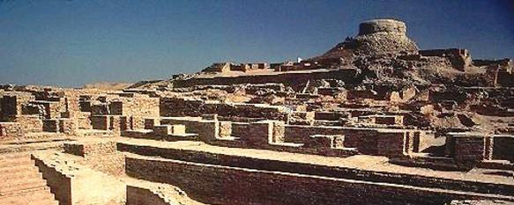
Pre Islamic Civilization of Subcontinent
Pakistan studies

Slide 2

What is History?

Slide 3
History means
Study of Past records
Dictionary: History (from Greek historia, meaning "inquiry, knowledge acquired by investigation") is the study of the past, particularly how it relates to humans.

Slide 4

History also means
His-Story

Slide 5

What is Pre-history?

Slide 6
Study of past which has no written records
Prehistory refers to the period of human existence before the availability of those written records with which recorded history begins. More broadly, it can refer to all the time preceding human existence and the invention of writing.

Slide 7
Pre-Islamic Civilization in Pakistan
Indus Valley Civilization
Gandhara Civilization
Aryaans Invasion
Empires
Kings

Slide 8
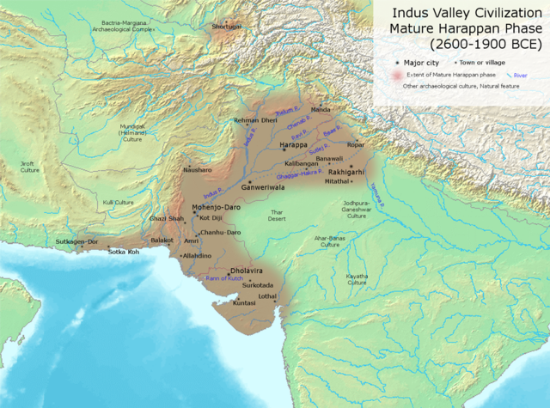
Indus Valley Civilization 3300 BC – 1300 BC

Slide 9
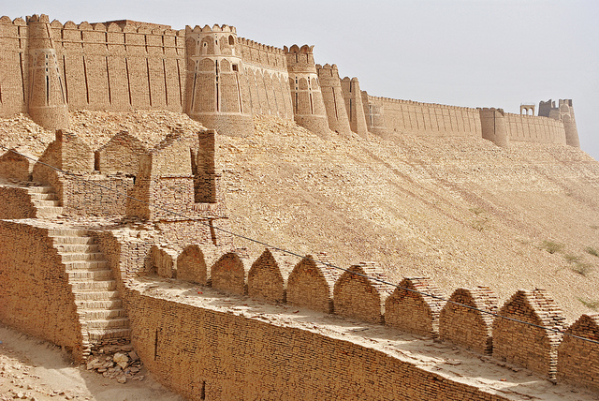
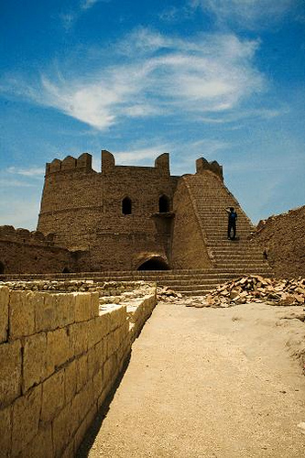
Indus Valley Civilization
Also include
Kot Diji
Aamri

Slide 10
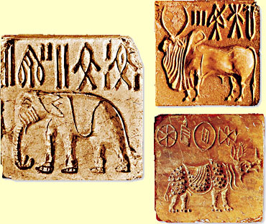
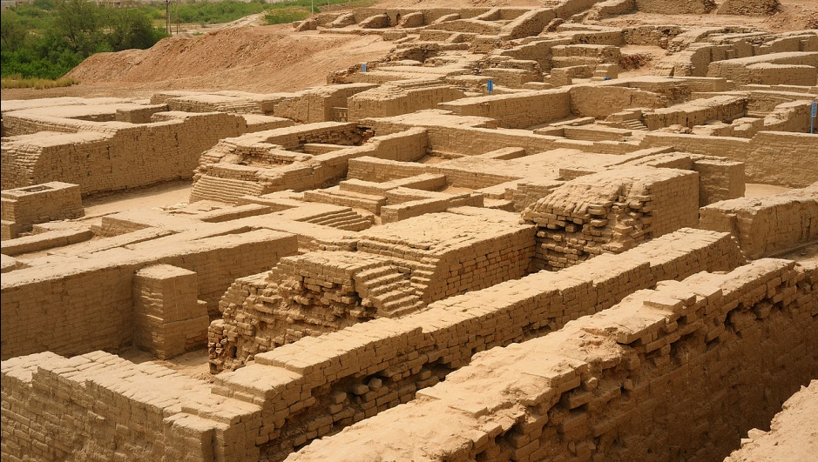
Moen jo Daro and Harappa
Seals
Script
Weights Technology
City Planning
Trade
State/Authority
Arts and Craft

Slide 11
Theories of Fall of Indus Valley Civilization
Aryan Invasion (Dasas or Dayus) Theory
Drought Theory
Change of River Course Theory
Economic and Trade reduction Theory

Slide 12
Vedic Period (Aryans) 1500 – 500 BC
Also bronze age
Rig veda, Yajur veda, Sama veda
and Atharva veda
Hymns, Poems, Prayers
Society was not divided in early stage
Varna, Vaishya and Shudar not mentioned in Vedas

Slide 13
Brahman Society and Emergence of Hinduism
Cast based Society
Brahmans, Kshatrya, Vaishya and Shudar (Dalit)
Raja from clan leaders to Kings and rulers
Iron age culture

Slide 14
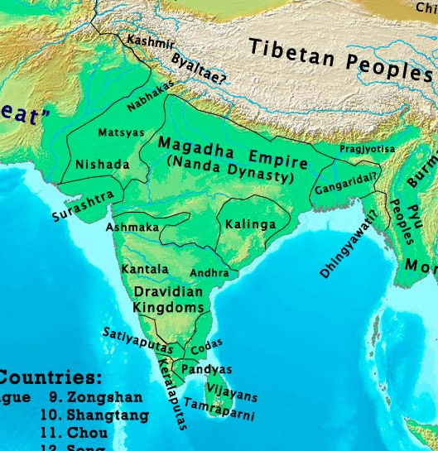

Slide 15
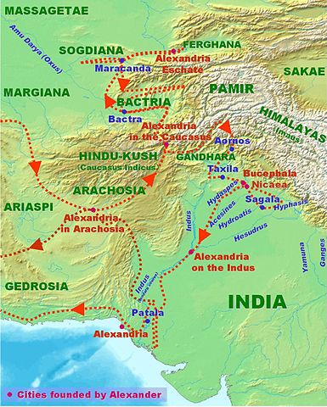
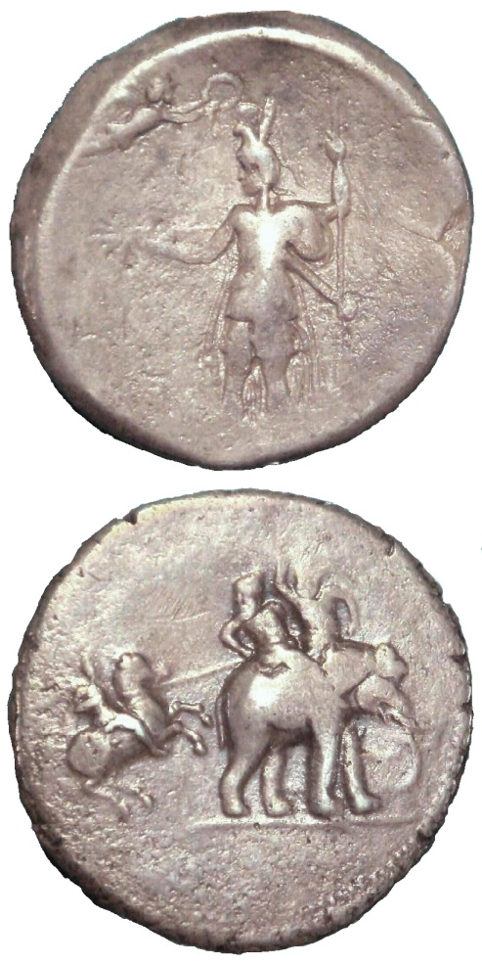
Alexander and Porus of Punjab 326 BC

Slide 16
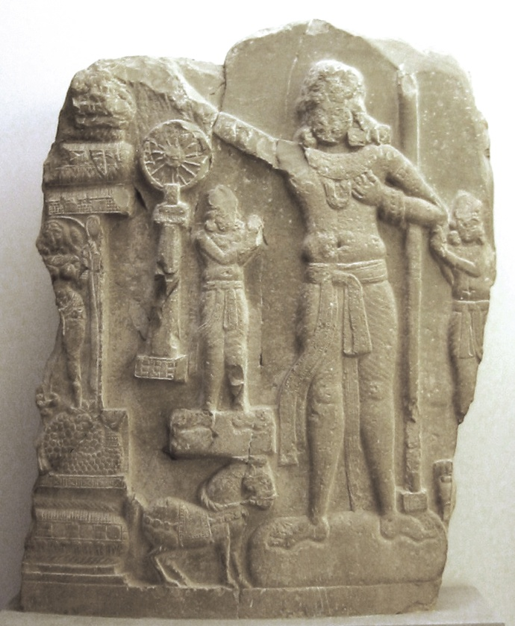
Mauryan Empire 322–185 BC
Chandragupta Maurya
Largest Empire of the World and India of that time
Ashoka and Kalinga war
Ashoka’s embrace of Budhism
Brihadrata, was last ruler of the Mauryan dynasty

Slide 17
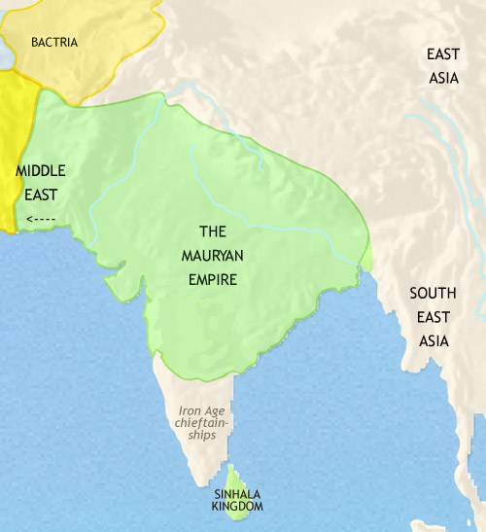

Slide 18
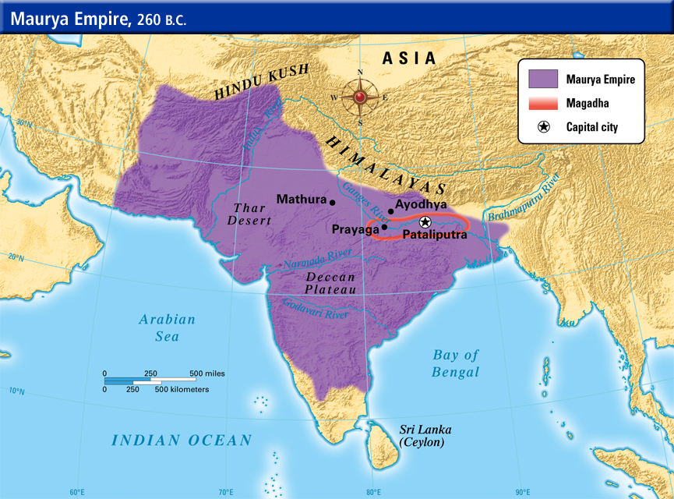

Slide 19
After Mauryan Empire
Kushans
Sassanid Empire
Kidarites
Gupta Empire
Rai Dynasty
Chach of Alor or Brahman Dynasty

Slide 20
The Society of Sindh at end of 7th and start of 8th Century AD.
Society
Economy
Religion
Rule
Ruler and his beliefs
Referred book for Todays Lecture
A History of the People of Pakistan: Toward Independence

Slide 21

Any Questions…

